Slide 1




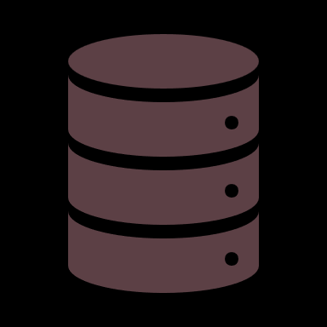




















Developer-Resources-Hub
A comprehensive collection of valuable resources for developers, covering job preparation, programming, frontend, backend, IoT, databases, and more.
Made with 💖 by Madhurima Rawat

Slide 2
Developer-Resources-Hub
A comprehensive collection of valuable resources for developers, covering job preparation, programming, frontend, backend, IoT, databases, and more.
Made with 💖 by Madhurima Rawat

